Slide 1
Fragments Part 3 – Dynamic Fragments
CS235AM
Android App Development
by Brian Bird
Spring 2016
Lane Community College

Slide 2
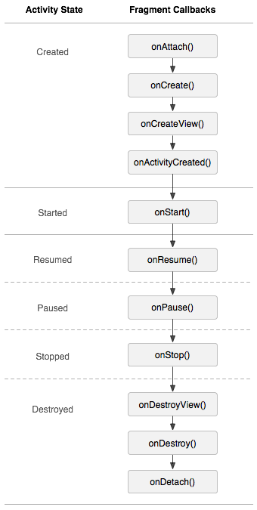
Fragment Life-Cycle

Slide 3
Small Screen
Each activity loads a single fragment (just like in part 1)
Activity AXML layout: instantiates a Fragment object
Fragment object: inflates fragment AXML UI layout
Fragment AXML UI layout is displayed by the activity
Activity: loads an AXML layout

Slide 4
Large Screen
Activity: loads an AXML layout
AXML layout: instantiates two Fragment objects
Fragment object: inflates AXML UI layout
Fragment object: inflates AXML UI layout
AXML UI layout is displayed by the activity
AXML UI layout is displayed by the activity

Slide 5
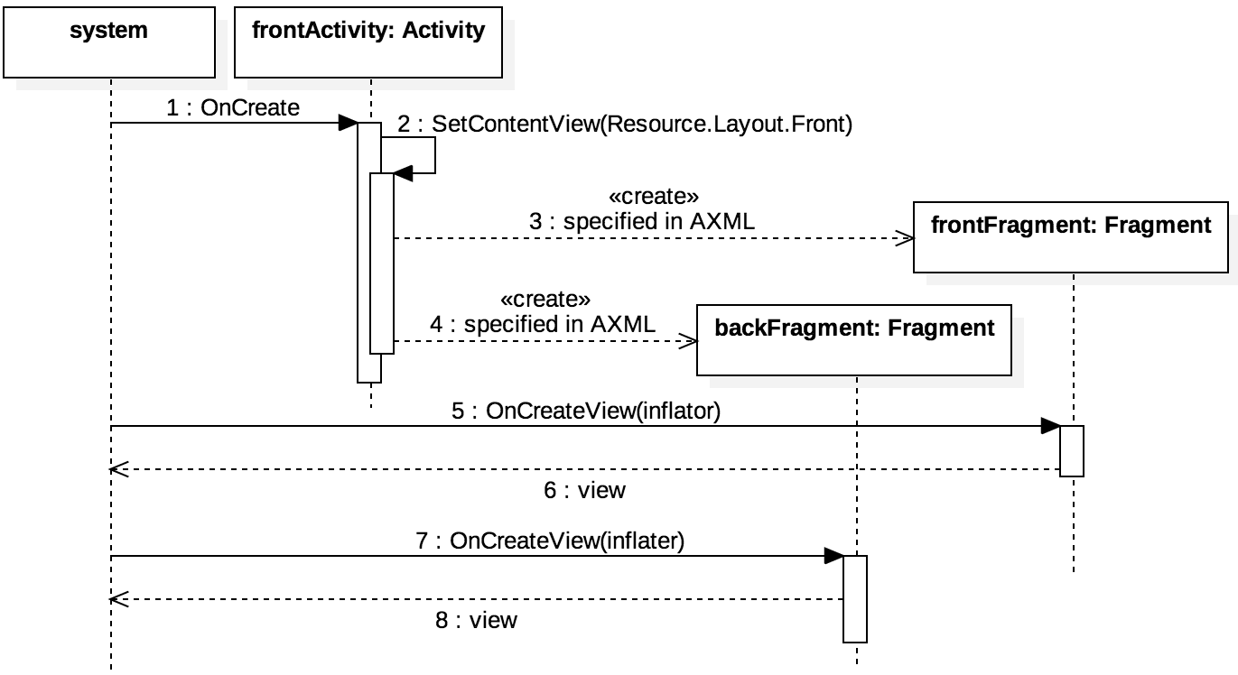
Large Screen Sequence

Slide 6
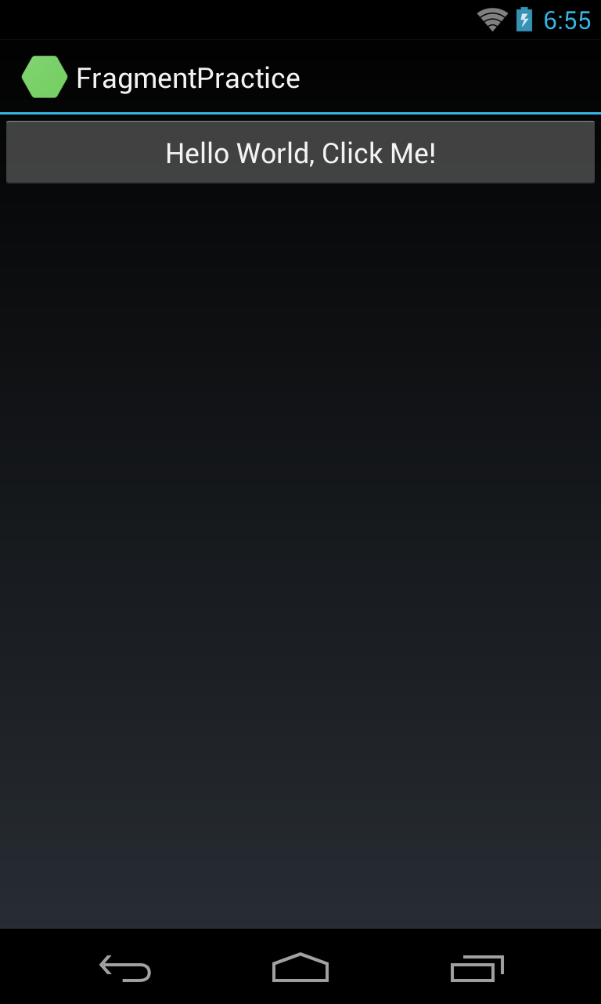
Example: Math Flash Cards

